Slide 1
Aim 1 Results

Slide 2
FV

Slide 3
1a: Single day effect story
Average stim has a nonzero effect on gait symmetry, while sham has no effect
However, STIM – SHAM is not different from zero
Final story: No difference in STIM vs. SHAM / STIM has no effect

Slide 4
1b: Stim parameters story
No difference between any stim parameters

Slide 5
1a: Single day effect
Dependent samples t-test of SHAM2 vs. average of the four interventions’ Cohen’s d

Slide 6
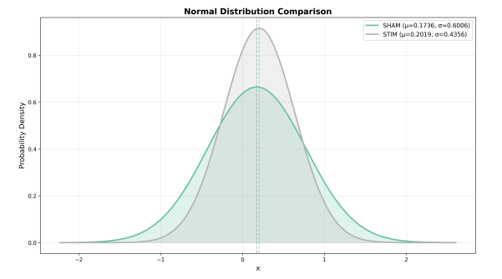
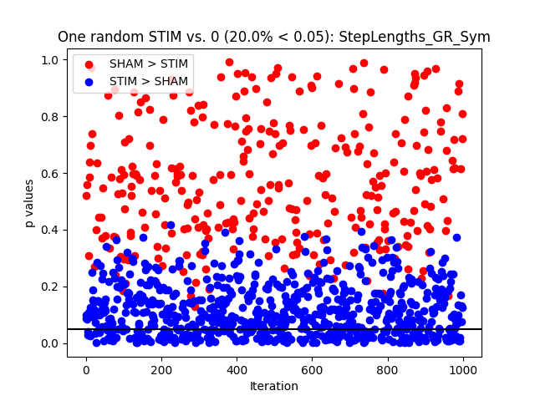
Step Lengths Sym
Sham vs. stim p=0.82
Sham vs. zero p=0.21
Stim vs. zero p=0.052
mean +/- std. dev Cohen’s d step lengths
Stim: 0.2 +/- 0.4
Sham: 0.17 +/- 0.6
Stim – sham: -0.02 +/- 0.55
Interpretation: NO STIM EFFECT
Notes:
"Y:\LabMembers\MTillman\GitRepos\Stroke-R01\results\stats\ttest_results\sham_vs_stim\symmetry\StepLengths_GR_Sym_ttest.pdf"

Slide 7
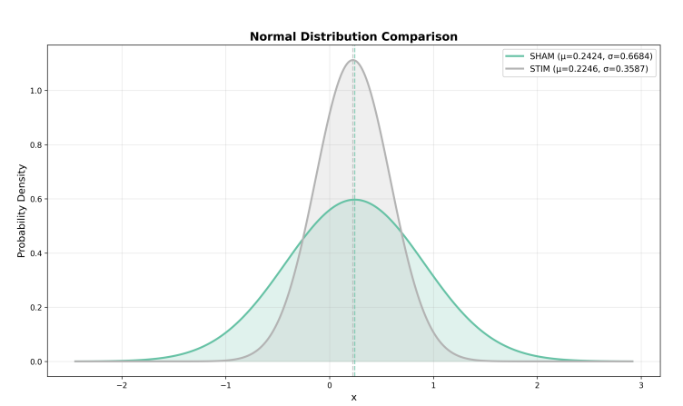
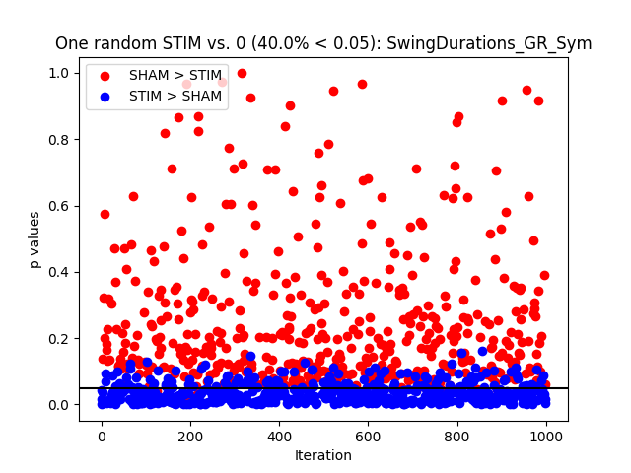
Swing Durations Sym
Sham vs. stim p=0.90
Sham vs. zero p=0.12
Stim vs. zero p=0.01
mean +/- std. dev Cohen’s d swing durations
Stim: 0.22 +/- 0.36
Sham: 0.24 +/- 0.67
Stim – sham: 0.02 +/- 0.62
Interpretation: NO STIM EFFECT
Notes:
"Y:\LabMembers\MTillman\GitRepos\Stroke-R01\results\stats\ttest_results\sham_vs_stim\symmetry\SwingDurations_GR_Sym_ttest.pdf"

Slide 8
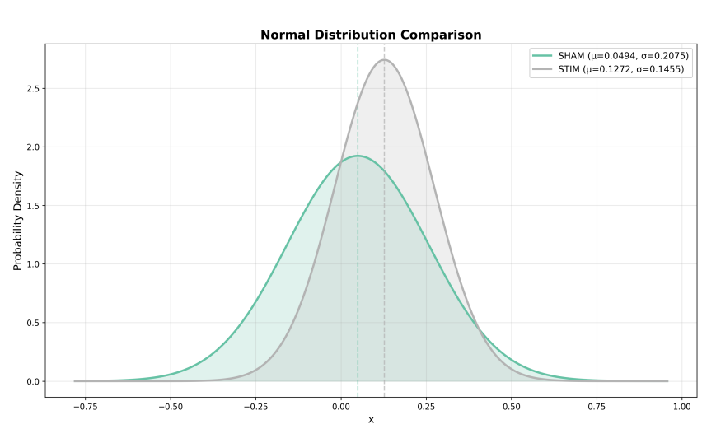
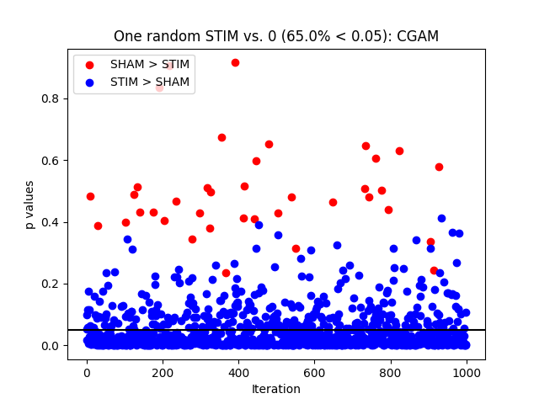
CGAM
Sham vs. stim p=0.20
Sham vs. zero p=0.30
Stim vs. zero p=0.0009
mean +/- std. dev Cohen’s d CGAM
Stim: 0.13 +/- 0.15
Sham: 0.05 +/- 0.21
Stim – sham: -0.08 +/- 0.26
Interpretation: STIM EFFECT
Notes:
"Y:\LabMembers\MTillman\GitRepos\Stroke-R01\results\stats\ttest_results\sham_vs_stim\symmetry\CGAM_ttest.pdf“
Figure from scientific notebook Aim 1

Slide 9
1b: Stim parameters
One way RM ANOVA of the four STIM interventions’ Cohen’s d

Slide 10
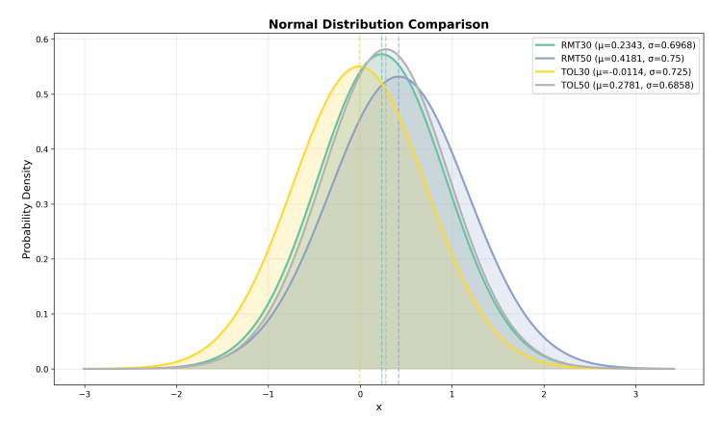
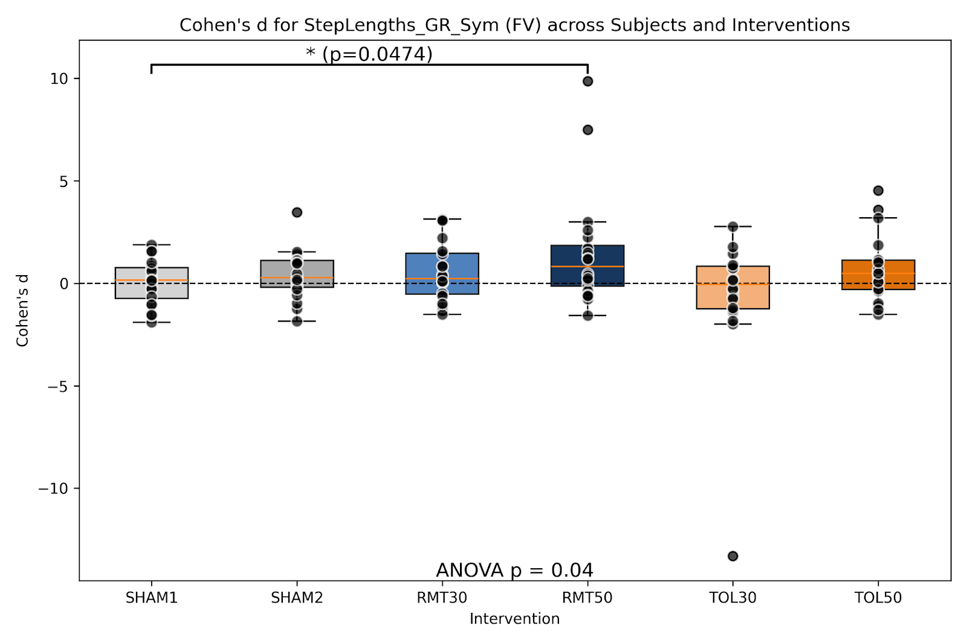
Step Lengths Sym
Omnibus p=0.20
Ignore p values on plot?
Notes:
"Y:\LabMembers\MTillman\GitRepos\Stroke-R01\results\stats\ANOVA results\between_interventions_cohensd_without_sham2\symmetry\StepLengths_GR_Sym_anova1way.pdf"

Slide 11
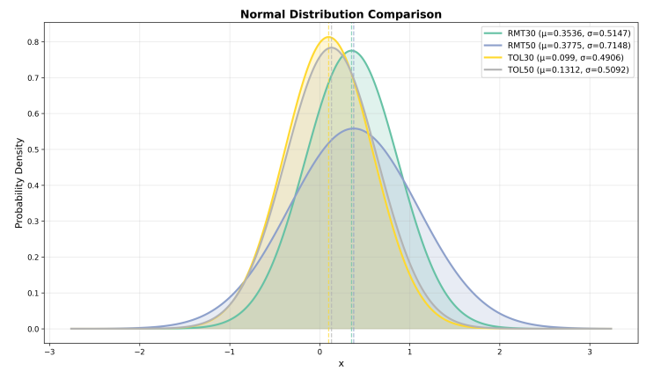
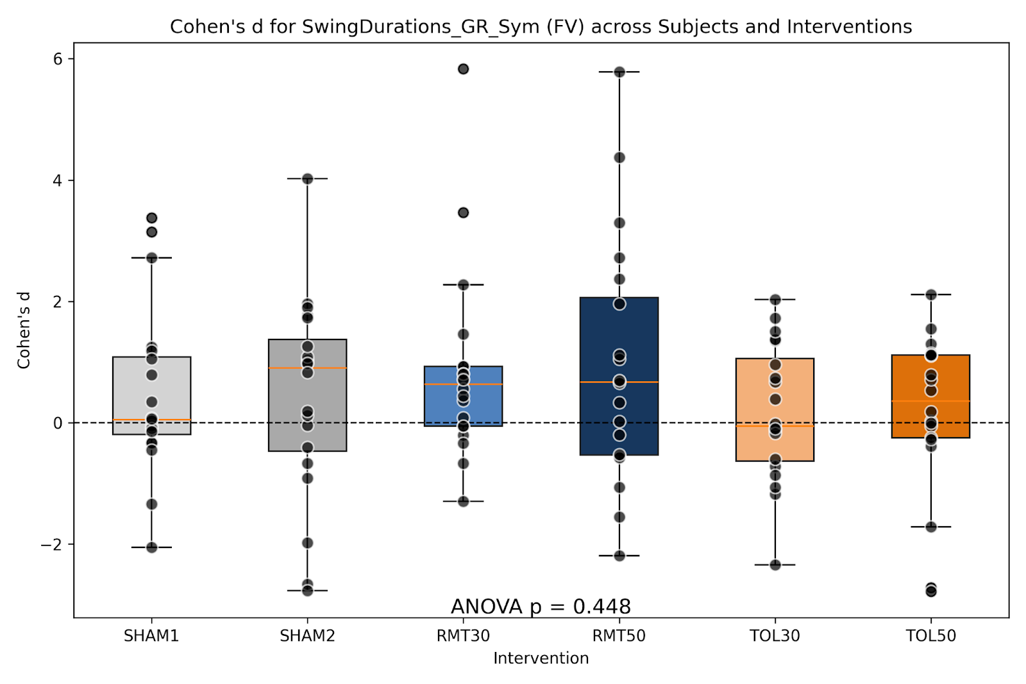
Swing Durations Sym
Omnibus p=0.19
Ignore p values on plot?
Notes:
"Y:\LabMembers\MTillman\GitRepos\Stroke-R01\results\stats\ANOVA results\between_interventions_cohensd_without_sham2\symmetry\SwingDurations_GR_Sym_anova1way.pdf“
Figure taken from scientific notebook Aim 1

Slide 12
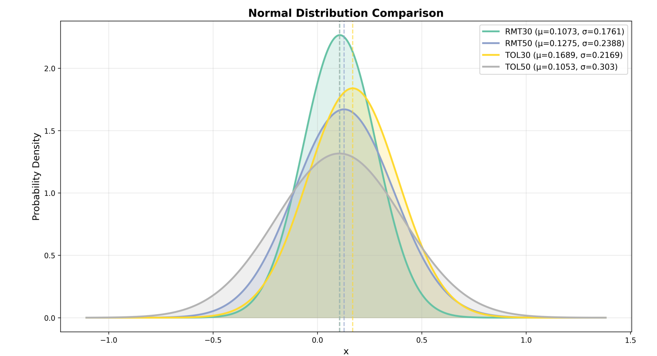
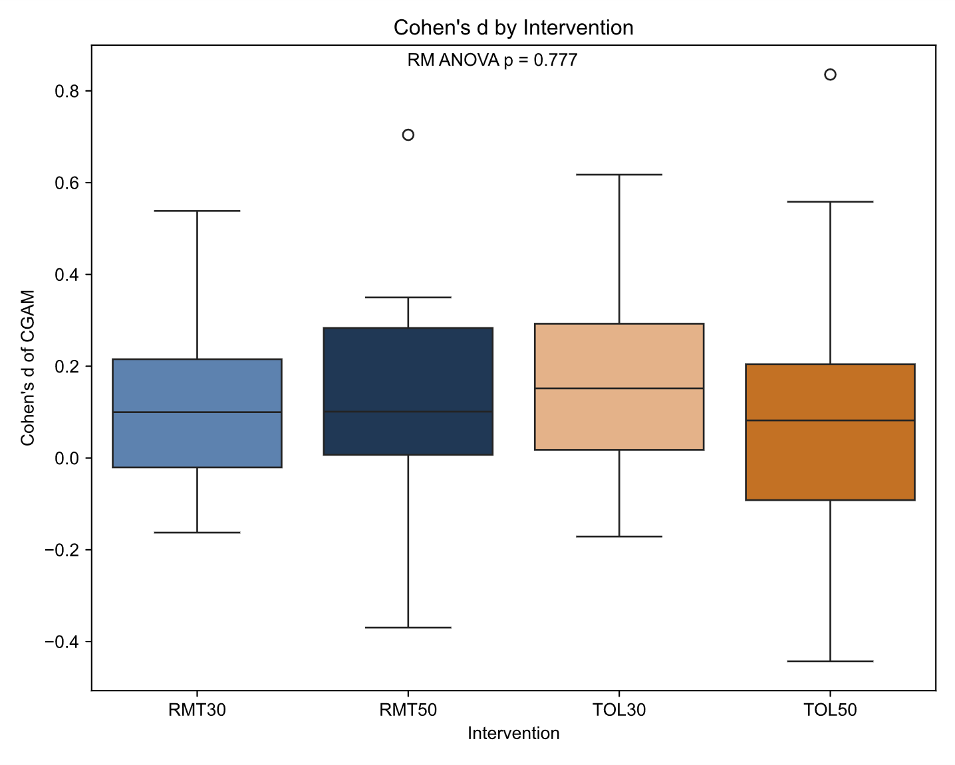
CGAM
Omnibus p=0.78
FV/SSV together?
Notes:
"Y:\LabMembers\J_Hunt\SS_Stroke\Per_Feature\Aim1_Paper\CGAM\figure2_CohenD_by_Intervention_CGAM.svg“
Figure taken from "Y:\LabMembers\J_Hunt\SS_Stroke\Per_Feature\Aim1_Paper\CGAM\figure2_CohenD_by_Intervention_CGAM.svg"

Slide 13
SSV

Slide 14
1a: Single day effect story

Slide 15
1b: Stim parameters story
No difference between any stim parameters

Slide 16
1a: Single day effect
Dependent samples t-test of SHAM2 vs. average of the four interventions’ Cohen’s d

Slide 17
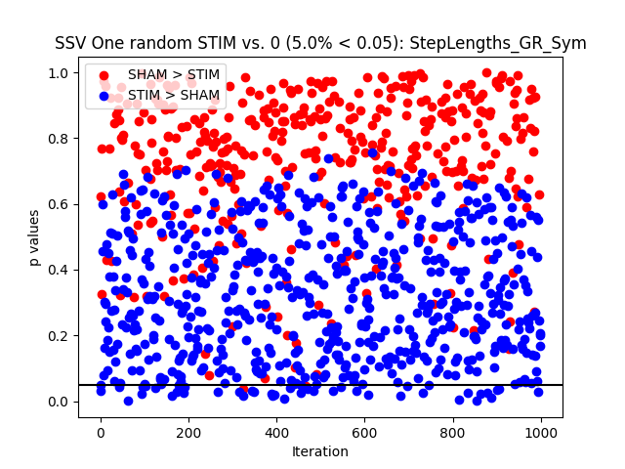
Step Lengths Sym
Sham vs. stim p=0.96
Sham vs. zero p=0.12
Stim vs. zero p=0.49
mean +/- std. dev Cohen’s d step lengths
Stim: 0.06 +/- 0.4
Sham: 0.07 +/- 0.5
Stim – sham: 0.006 +/- 0.55
Interpretation: NO STIM EFFECT
Notes:
"Y:\LabMembers\MTillman\GitRepos\Stroke-R01\results\stats\ttest_results\sham_vs_stim\symmetry\StepLengths_GR_Sym_ttest.pdf"

Slide 18
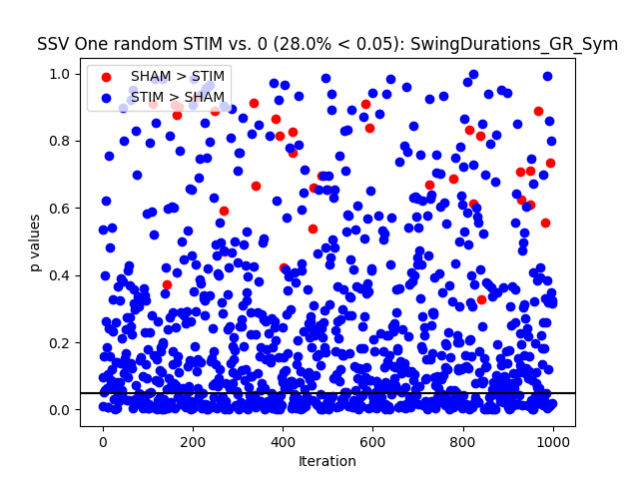
Swing Durations Sym
Sham vs. stim p=0.10
Sham vs. zero p=0.89
Stim vs. zero p=0.016
mean +/- std. dev Cohen’s d swing durations
Stim: 0.17 +/- 0.29
Sham: -0.02 +/- 0.5
Stim – sham: -0.19 +/- 0.48
Interpretation: NO STIM EFFECT
Notes:
"Y:\LabMembers\MTillman\GitRepos\Stroke-R01\results\stats\ttest_results\sham_vs_stim\symmetry\SwingDurations_GR_Sym_ttest.pdf"

Slide 19
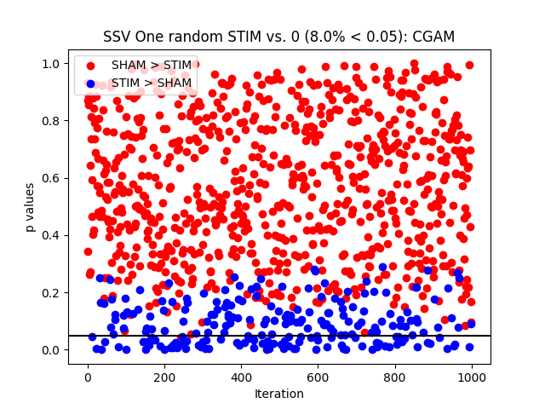
CGAM
Sham vs. stim p=0.56
Sham vs. zero p=0.32
Stim vs. zero p=0.25
mean +/- std. dev Cohen’s d CGAM
Stim: 0.03 +/- 0.11
Sham: 0.07 +/- 0.3
Stim – sham: 0.04 +/- 0.28
Interpretation: NO STIM EFFECT
Notes:
"Y:\LabMembers\MTillman\GitRepos\Stroke-R01\results\stats\ttest_results\sham_vs_stim\symmetry\CGAM_ttest.pdf“
Figure from scientific notebook Aim 1

Slide 20
1b: Stim parameters
One way RM ANOVA of the four STIM interventions’ Cohen’s d

Slide 21
Step Lengths Sym
Omnibus p=0.57
Notes:
"Y:\LabMembers\MTillman\GitRepos\Stroke-R01\results\stats\ANOVA results\between_interventions_cohensd_without_sham2\symmetry\StepLengths_GR_Sym_anova1way.pdf"

Slide 22
Swing Durations Sym
Omnibus p=0.19
Notes:
"Y:\LabMembers\MTillman\GitRepos\Stroke-R01\results\stats\ANOVA results\between_interventions_cohensd_without_sham2\symmetry\SwingDurations_GR_Sym_anova1way.pdf“
Figure taken from scientific notebook Aim 1

Slide 23
CGAM
Omnibus p=
Notes:
"Y:\LabMembers\J_Hunt\SS_Stroke\Per_Feature\Aim1_Paper\CGAM\figure2_CohenD_by_Intervention_CGAM.svg“
Figure taken from "Y:\LabMembers\J_Hunt\SS_Stroke\Per_Feature\Aim1_Paper\CGAM\figure2_CohenD_by_Intervention_CGAM.svg"

